Slide 1
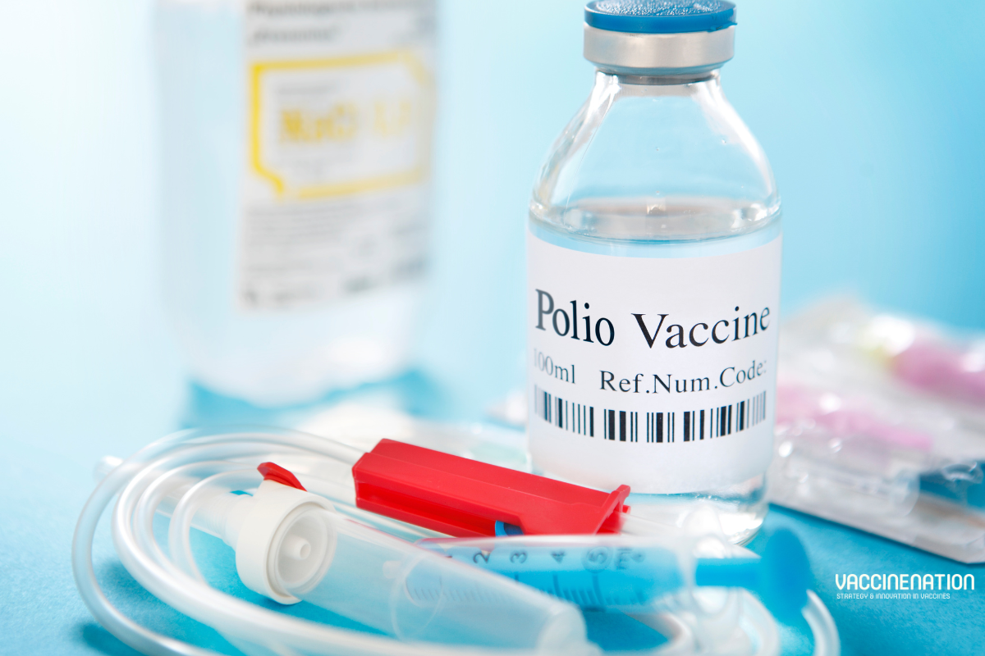
Polio Immunization: A Step Towards Eradication
Md Rezwan Hasan Tamim
Department of Chemistry

Slide 2
What is Polio?
Polio, or poliomyelitis, is a highly infectious viral disease caused by the poliovirus. It primarily affects young children and spreads through contaminated water, food, or contact with an infected person. The virus attacks the nervous system and can cause symptoms such as fever, fatigue, headache, vomiting, stiffness in the neck, and pain in the limbs.
Symptoms: Fever, fatigue, headache, stiffness.

Slide 3
Polio Eradication Efforts
Global Polio Eradication Initiative (GPEI)
Vaccination Campaigns
Surveillance Systems
Public Awareness Campaigns

Slide 4
The Importance of Vaccination
Protects Individuals from Disease
Prevents Disease Spread
Reduces Mortality and Morbidity
Cost-Effective Health Strategy
Contributes to Global Health Goals
Builds Long-Term Immunity

Slide 5
Global Campaigns and Success Stories
Smallpox Eradication
Polio Elimination in Most Regions
Drastic Reduction in Measles Mortality
Elimination of Rubella in the Americas

